Slide 1
Image classification
Rafał Klinowski, Jakub Cisowski
Biologically inspired artificial intelligence, sem. 6

Slide 2
What is image classification?
Categorizing images
Tries to answer the question: „What is in the picture?”
Based on pixels or vectors within an image
Tries to recognize patterns within an image to make predictions
We explore „single-label classification” which only assigns one value to an image

Slide 3
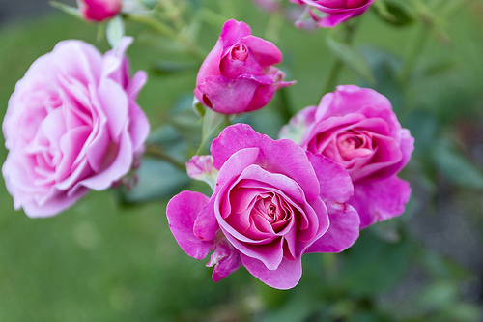
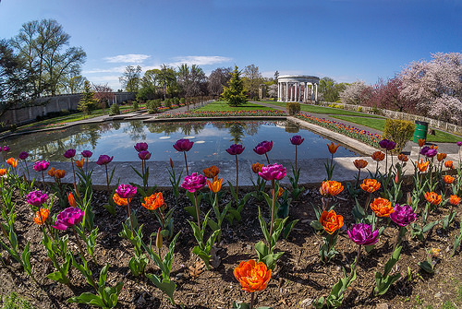
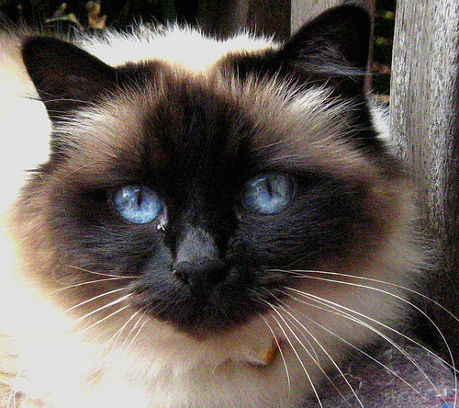
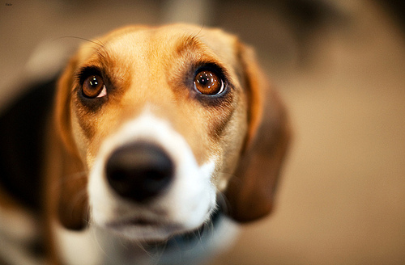
Roses
Tulips
Cat
Dog

Slide 4
Real life examples of image recognition
Medicine – eg. to help doctors detect abnormalities such as cancer
Self-driving cars
Face ID and other facial recognition systems
Retail – eg. the ability to try on a piece of clothing online

Slide 5
Our project

Slide 6
Distinction between cat and dog breeds
One step further than just saying „dog or cat”
Input: an image
Output: name of dog or cat breed as well as certainty (in %)

Slide 7
84% Birman
98% Beagle

Slide 8
Dataset used for training
Courtesy of The University of Oxford
JPG image files
37 cat or dog races
About 200 images for each breed
Over 7390 images in total
Various sizes (have to be standardized before training)

Slide 9
Description of technology
Programming language: Python
TensorFlow – used to create, train, save and load model
Keras – used to simplify data loading and dividing into different categories
MatPlotLib – used to generate plots describing model performance, accuracy
Algorithm:
Divide images into groups based on breed
Calculate minimum, maximum and average image size (used when creating model)
Load data, split into two groups: training, validation
Create, compile, train and evaluate model
Save model as a group of files

Slide 10
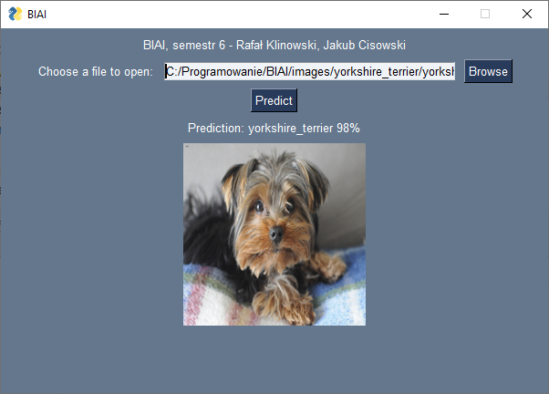

Slide 11
Research
We built and trained our model multiple times with different parameters to test their impact on performance

Slide 12
Key parts of the code

Slide 13
target_size, input_shape
represents the size to which all images will be resized when first loaded
larger values require significantly more memory and longer training time
smaller values mean there are less trainable parameters – model will be less accurate
common values include: 96x96, 160x160, 224x224

Slide 14
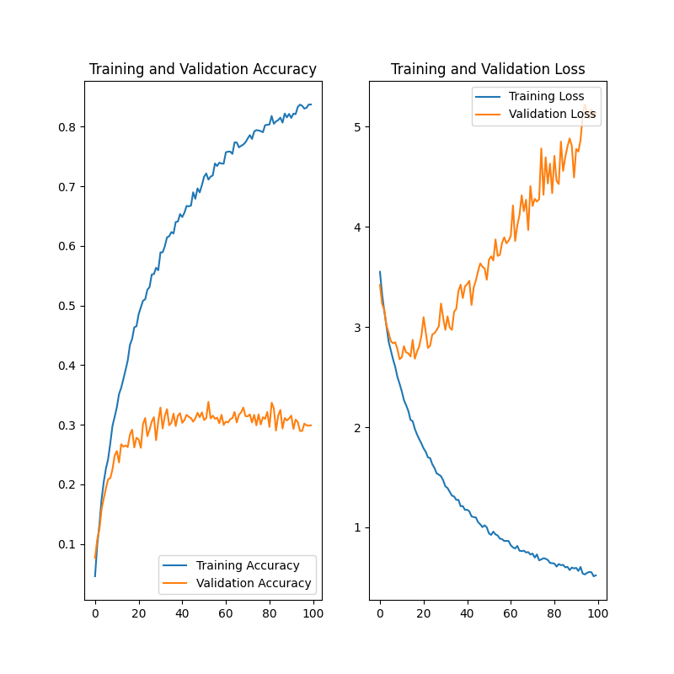
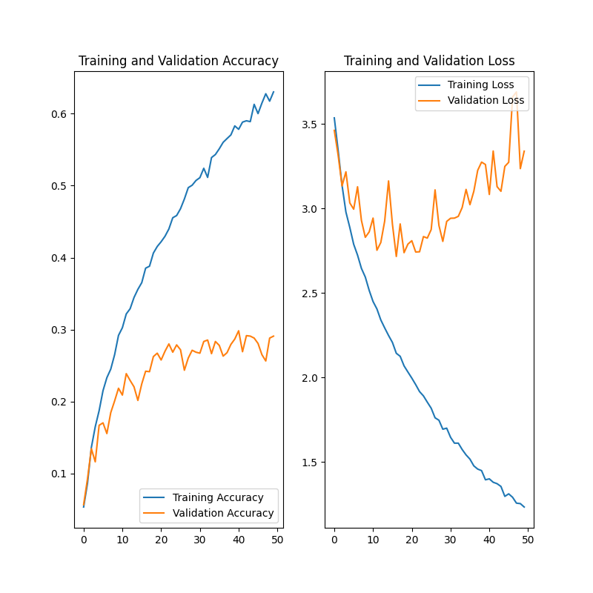
target_size=(224,224)
(note: different scale)
target_size=(96,96)
training time ≈ 20 hours
training time ≈ 45 minutes

Slide 15
batch_size
the number of images in a batch, used to perform one step of training
if too small, then we end up approximating the function with too few examples that might not be representative of all training data
if too large, requires a lot of memory and can even run out of it during training which is then interrupted
common values are 16, 32, 64

Slide 16
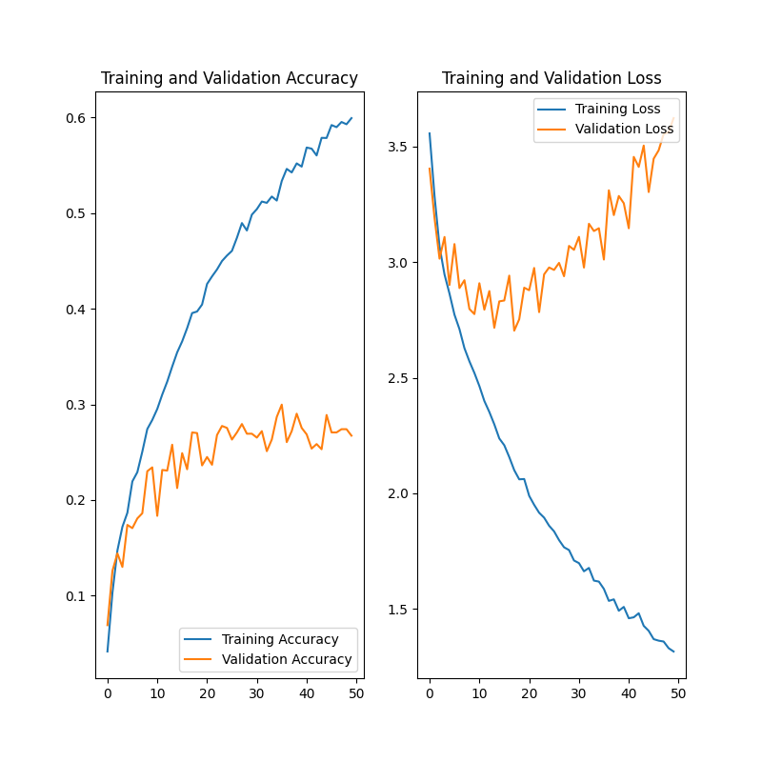
batch_size=16
(note: not enough memory to run 32)
batch_size=8
training time ≈ 45 minutes
training time ≈ 3 hours

Slide 17
validation_split
the percentage of training images used for validation
the rest of images is used for training only
the dataset we used did not provide a separate set for validation – thus we had to use split
common value is 20%

Slide 18
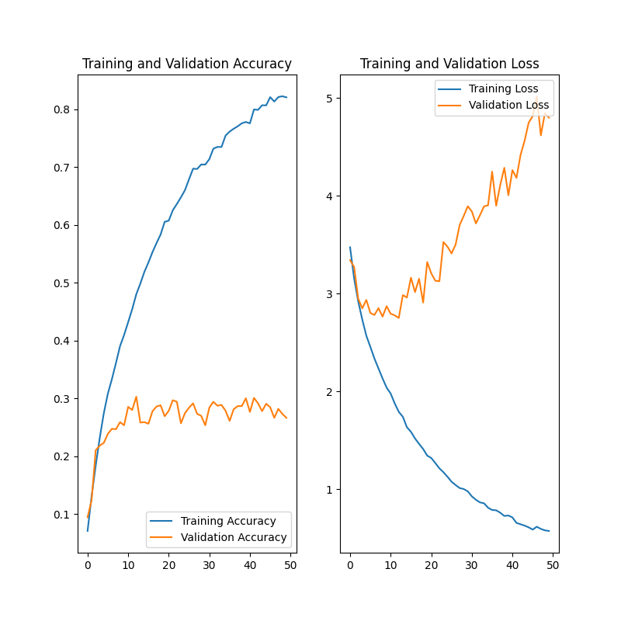
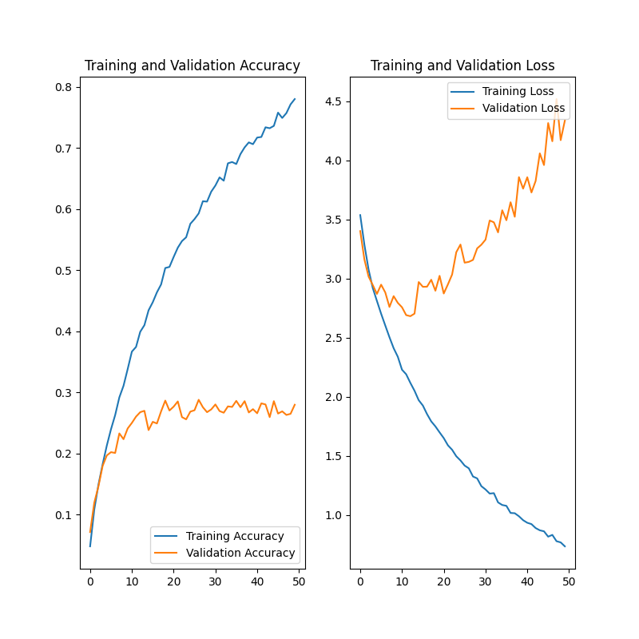
validation_split=0.2
validation_split=0.3
training time ≈ 45 minutes
training time ≈ 45 minutes

Slide 19
shuffle
random ordering of images in training set
commonly used to improve training accuracy
prevents the model from learning the order of images
helps with training time as well due to „prefetch” (some images are ready to be used in memory)
shuffle parameter tells how many points to keep in memory for random drawing

Slide 20

shuffle(1000)
no shuffle
training time ≈ 45 minutes
training time ≈ 50 minutes

Slide 21
data_augmentation
helps diversify data
improves accuracy
we used three functions: RandomFlip (flips some of the images), RandomRotation (rotates some of the images slightly) and RandomZoom (zooms in or out on some of the images slightly)
tested values: 0.1 and 0.2

Slide 22
Creating the model
we could use many different layers in different orders or with different parameters
most room for experimenting

Slide 23
Layers used in the final model
The model used is Sequential, which means the layers are applied in order
data_augmentation – explained before
Rescaling – normalizes pixel values for images (from 0 – 255 to 0.0 – 1.0)
Conv2D – Convolution Layer, performs element-wise multiplication on some parts of the input matrix at a time, outputs a different matrix
MaxPooling2D – downsamples the input for each channel of input by choosing max value from each feature vector patch
Dropout – randomly drops out (sets to zero) some inputs
Flatten – flattens the input (reduces multidimensional vectors to a single dimension array)

Slide 24
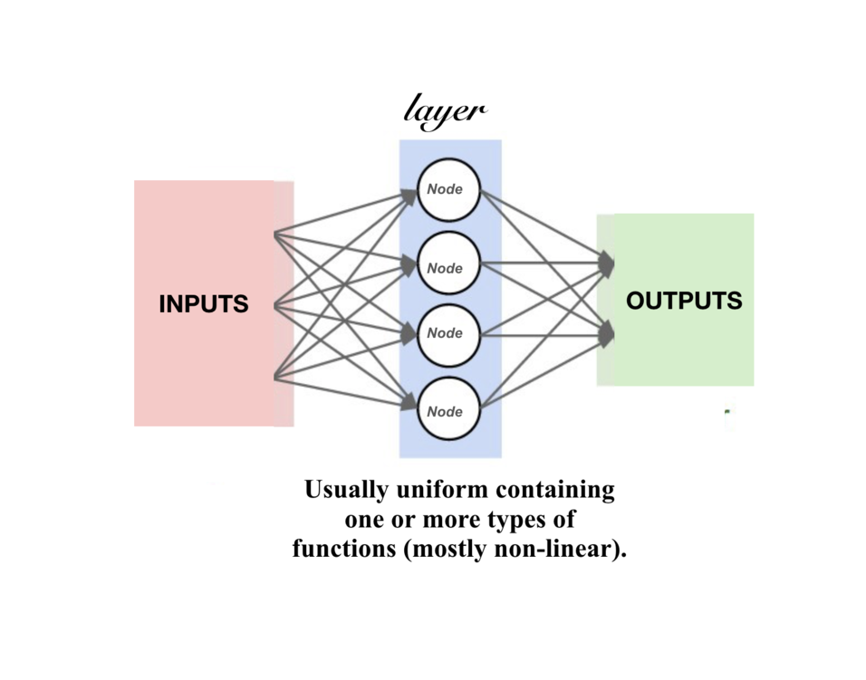
What is a layer?
A layer is a structured used to pass information
Takes one or more inputs, applies a transformation, and has one or more outputs
Input itself is a layer too
Transformations are mostly non-linear functions

Slide 25
’Rescaling’ layer
It’s necessary to normalize input data
Makes all layers and features work on the same level of scale (0.0 – 1.0) instead of having different scales (0-1, 0-255, etc.)

Slide 26
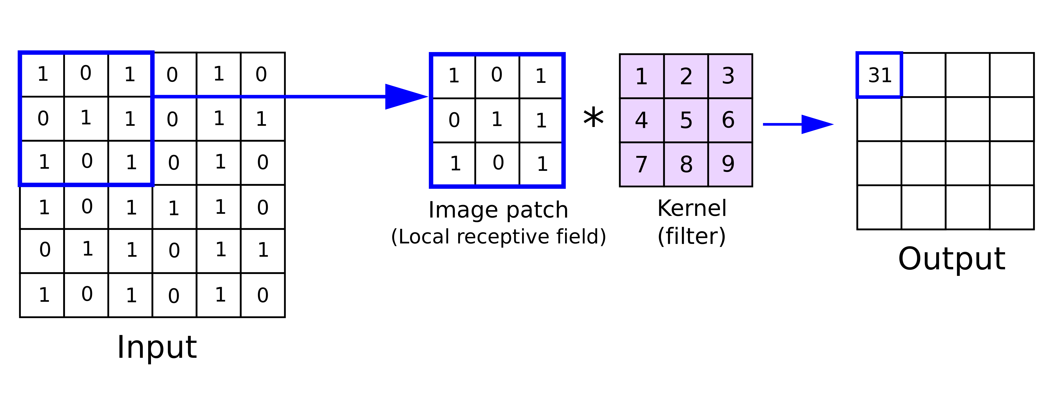
’Conv2D’ layer
Performs element-wise multiplication on some parts of the input matrix at a time
Outputs a different matrix

Slide 27
’Dense’ layer
applies a non-linear transform on data
each neuron in Dense layer receives input from all neurons from previous layer
activation function passed as parameter
for activation function we used ReLU – returns input if it’s positive, otherwise returns zero; it’s fast, simple and universally works well
parameter – number of outputs
second Dense layer – output size is equal to the amount of classes we have (37)

Slide 28
’Dense’ layer – cont.

Slide 29
’Dropout’ layer
Used to prevent overfitting
Overfitting – situation when model predicts „too well” on training data, and therefore is not very accurate at making predictions from outside of training set
By randomly dropping out some of inputs we get a more diverse, less dependent set

Slide 30
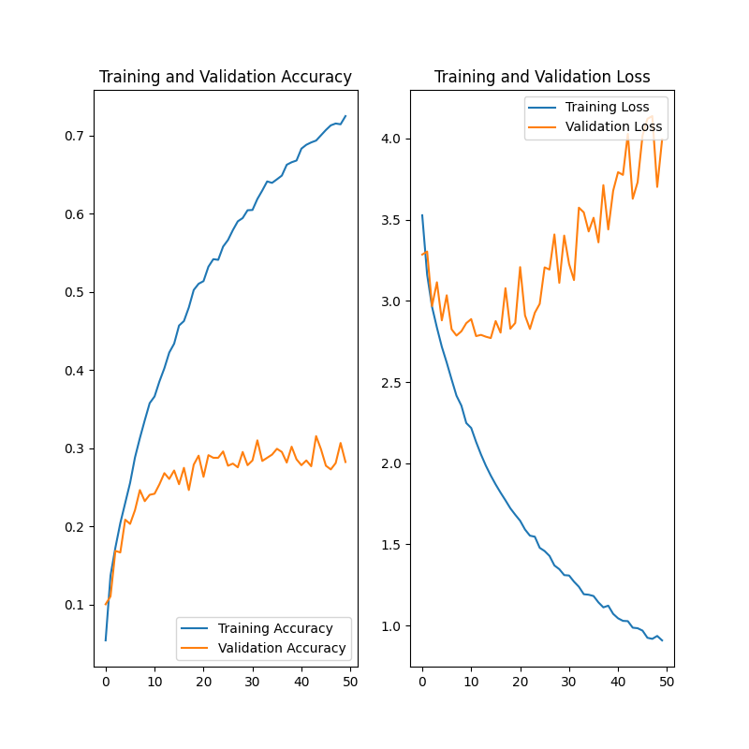
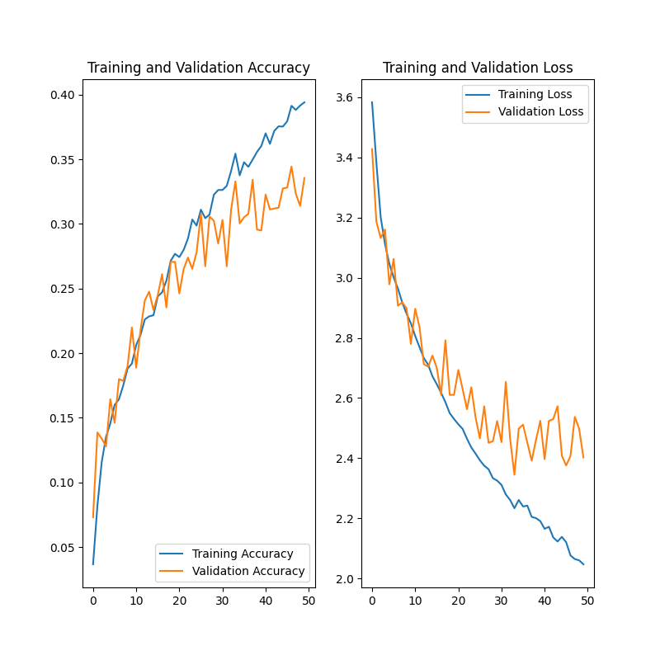
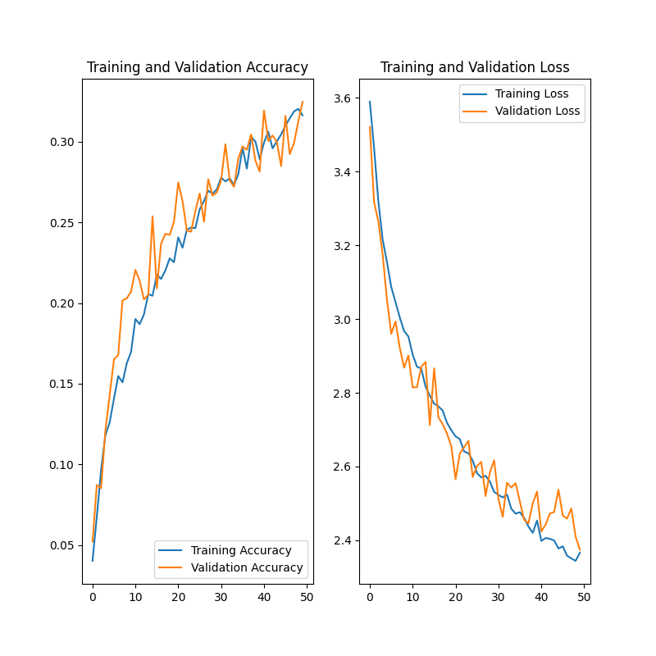
default (dropout 0.2)
dropout 0.2 twice
dropout 0.4 twice
Notes:
TODO: powiedzieć że 0.4 żeby dało dobre rezultaty wymagałoby znacznie zwiększonych innych parametrów modelu, a na to nie mieliśmy sprzętu

Slide 31
Other experiments
We experimented with many different layer combinations and even some pretrained models
All experiments are compared with the ’final model’ described previously
Two most relevant attempts: modifying the sequence (using the same layers but in different order), adding significantly more layers

Slide 32
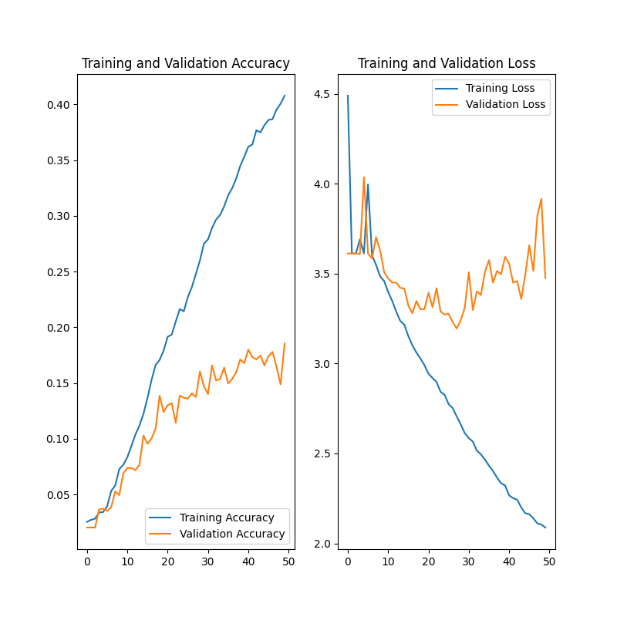
default
modified sequence

Slide 33
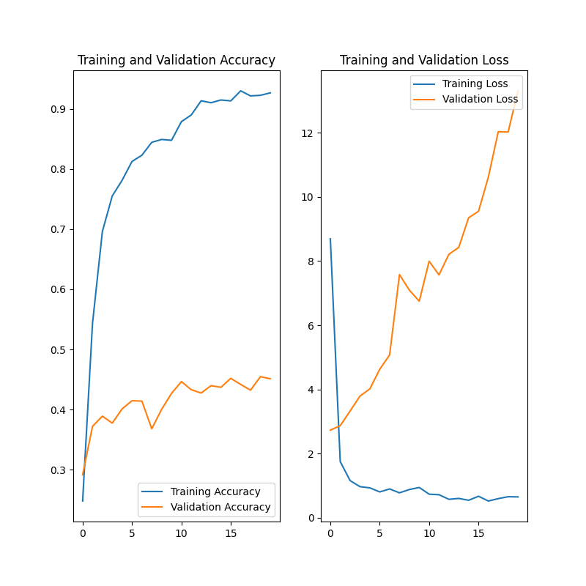
(note: different scale)
default
significantly more layers
Notes:
TODO: powiedzieć czemu nie daliśmy more layers mimo lepszej accuracy (znacznie zwiększony czas treningu, validation loss)

Slide 34
Optimizer
Specified during model compilation
Specific algorithms used for model training
Have different speed and performance based on data and other parameters
Different parameters: learning rate, decay rate, functions
Affect loss function – try to reduce losses

Slide 35
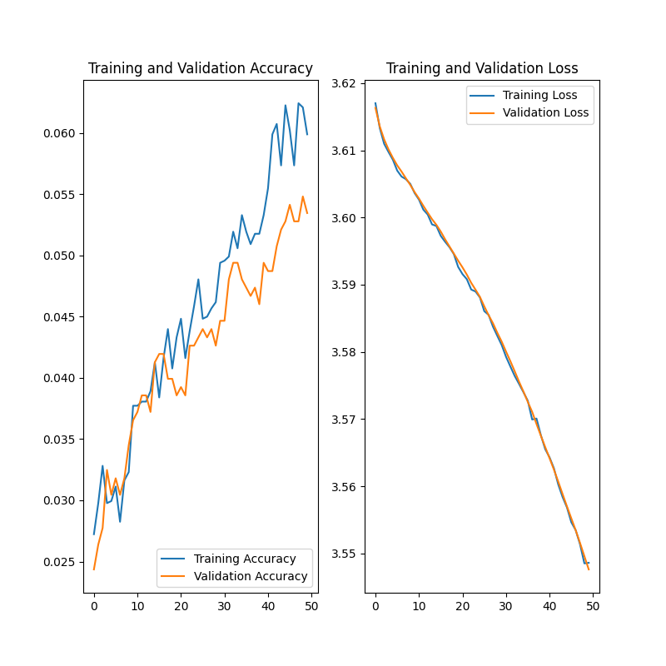
Adam
Adadelta
NAdam

Slide 36
Epochs
Amount of training iterations
Each iteration, all samples are passed though the neural network once
More does not necessarily mean better – after a certain amount of iterations, accuracy stays nearly constant or even goes down
For research, we mostly used epochs=50 – good middleground between short training time and decent results

Slide 37
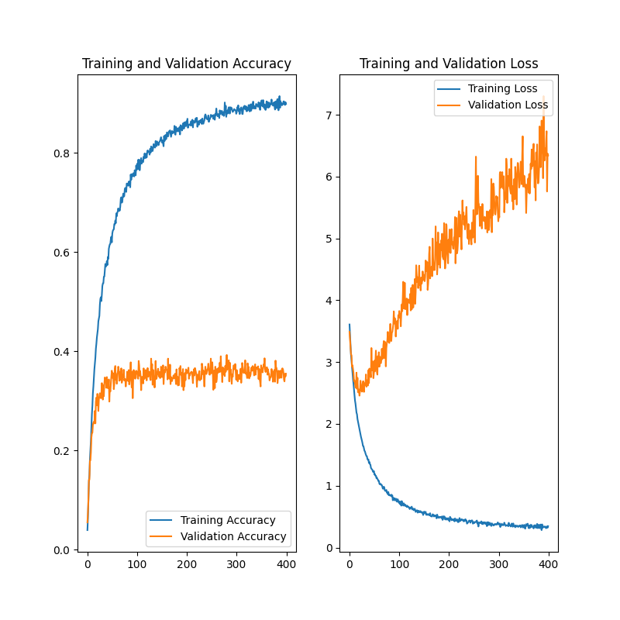
Final model performance

Slide 38
Conclusions
The dataset we used was not big enough to fully prevent overfitting, and to keep training accuracy as close as possible to validation accuracy
We had to settle for some unoptimized parameters (eg. batch_size) – hardware problems
The final model performs very well on training data

Slide 39
Problems we encountered
Main problem – because the model is only trained on 37 classes of data, it cannot distinguish other classes (other breeds of dogs or cats)
When passing an image that does not belong to these 37 classes, we will not get good results

Slide 40
Sources
https://www.kaggle.com/datasets/zippyz/cats-and-dogs-breeds-classification-oxford-dataset
https://www.tensorflow.org/
https://docs.python.org/3/reference/
https://machinelearningknowledge.ai/
https://towardsdatascience.com/
https://anhreynolds.com/blogs/cnn.html
https://iq.opengenus.org/purpose-of-different-layers-in-ml/

